Slide 1
Online Central Records System
User’s Manual

Slide 2
Before Using the Program
Things to Remember:
1. The program is an application—it is offline, but it uses a browser to be accessed through the network
2. The address of the program, placed on the browser, is only one way of accessing the program. A more direct way is to call the name of the Server, in this case, http://SDUServer/

Slide 3
How to use for the First Time
1. It’s browser-based; so you have to open your browser. Doesn’t matter which—either Mozilla, IE, Opera, or Safari
2. In the Address box of the browser, type the IP address of the Server—or the PC name, which is http://SDUServer/. That’s all we type, because the program automatically switches to the main page…

Slide 4
Next Step: the Login and Accounts Page
The first page that appears before us is the Login page. To be able to log in, however, you would need to create a new account first. You can find that on the link below the login
To create a new Account, you would need to obtain the Security Phrase assigned to your department. For that, you would need to ask the Records Officer.

Slide 5
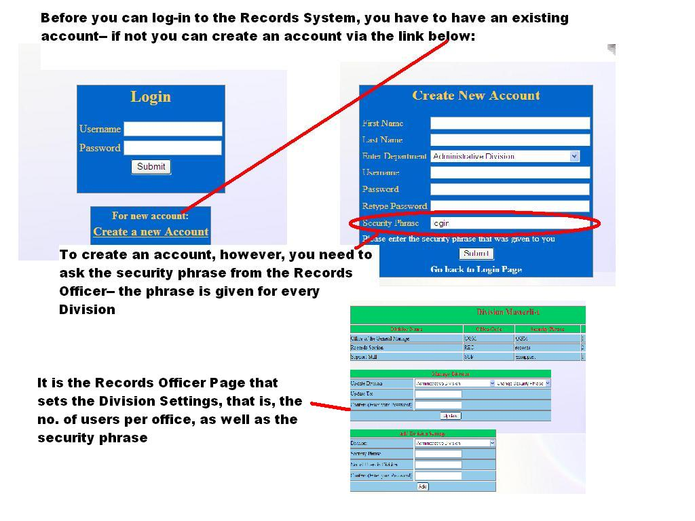

Slide 6
Entering the Main Page
The Main Page of the old Records Program was messy, long and cluttered.
To better organize the layout, the new Records Program introduced a tabbed interface.
Options are now divided into tabs, and these tabs show the different, independent functions of the system.

Slide 7
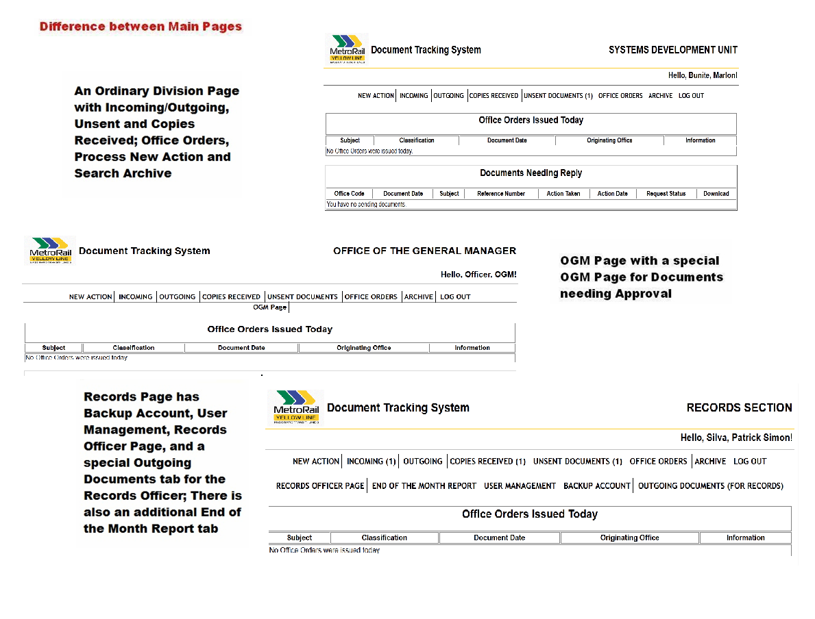

Slide 8
The Life Cycle of a Document (Step 1: Creating a new Record)
For the non-OGM/Records Division, receiving, or issuing a document is done by clicking on “New Action” tab. This is the first tab.
The tab will now show the option to create, issue or receive documents, the option of issuing incoming/outgoing documents, or memoranda.

Slide 9
The Life Cycle of a Document (Step 1: Creating a new Record)
The other option is to select GM-secured, Division-secured, or Unsecured
Selecting the security level will decide whether the sent Document will go through the General Manager or not
Selecting the type of document will decide whether you will go through the Routing Page or not.

Slide 10
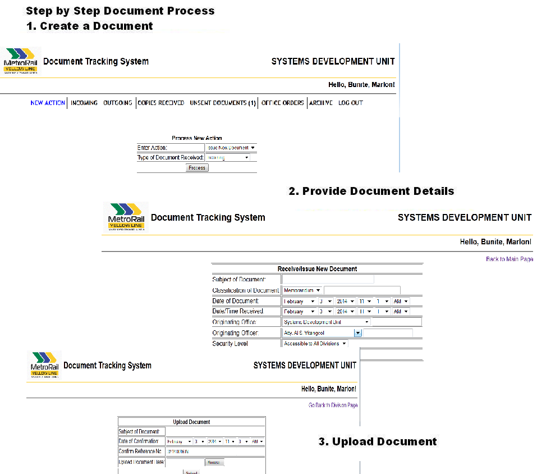

Slide 11
The Life Cycle of a Document (Step 1: Creating a new Record)
After creating the document, the next two pages will make you enter the document details and upload the physical (hard copy) of the document.
Going through the next section, you will understand how this physical process goes throughout the Records System.

Slide 12
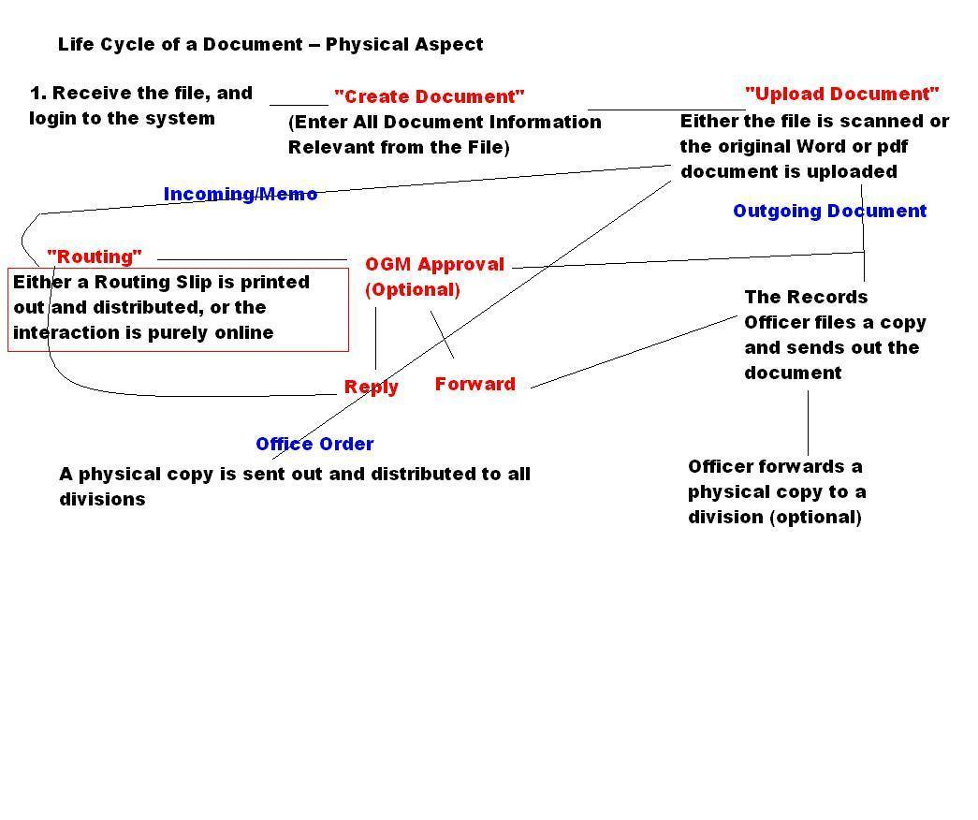

Slide 13
The Life Cycle of a Document (Step 2: Routing the Document)
For Incoming or Memo Documents, after uploading the Document on the next Page, the Routing Report Page will appear.
The Routing Report Page is a summary of all actions and destination that were done to the document. The newly created Document will have the table empty, but that also means there’s no destination yet for the document.
To send the document, select new Action on the Routing Report; the next two pages will show a.) the originating office, b.) where it is going

Slide 14
The Life Cycle of a Document (Step 2: Routing the Document)
The first page after the Report, you will enter basically what Office the document was first received, or issued.
The next page is also a report, only that it shows all the destinations of that document at that new action you are creating.
You can decide to “Send to All” or send one division at a time (maybe not to all, but to two or three). After inserting the destination, if you are satisfied that the Report will now send to all the needed destinations, you can now exit to the main Routing Report

Slide 15
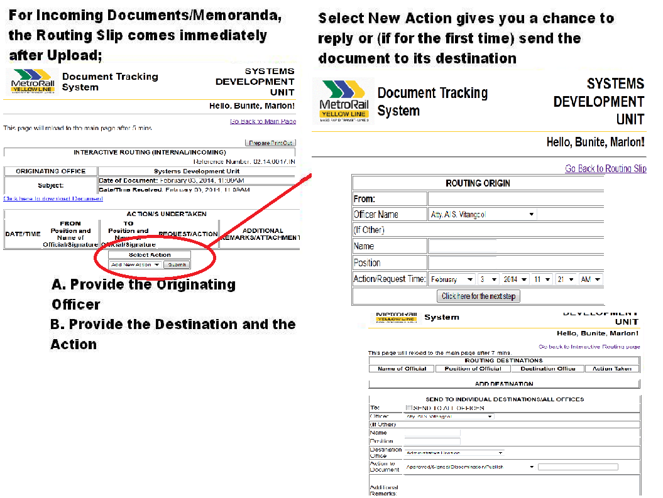

Slide 16
The Life Cycle of a Document (Step 2A- The GM secured document)
If the security level of the document is “GM secured”, it would need approval from the GM before going to its intended destination(s)
The GM can decide to reject the document (effectively closing it), approve it for distribution, or ask for clarification
Asking for clarification works also as a routing action, and the GM sends a request to an office for that clarification in a sense of routing it.

Slide 17
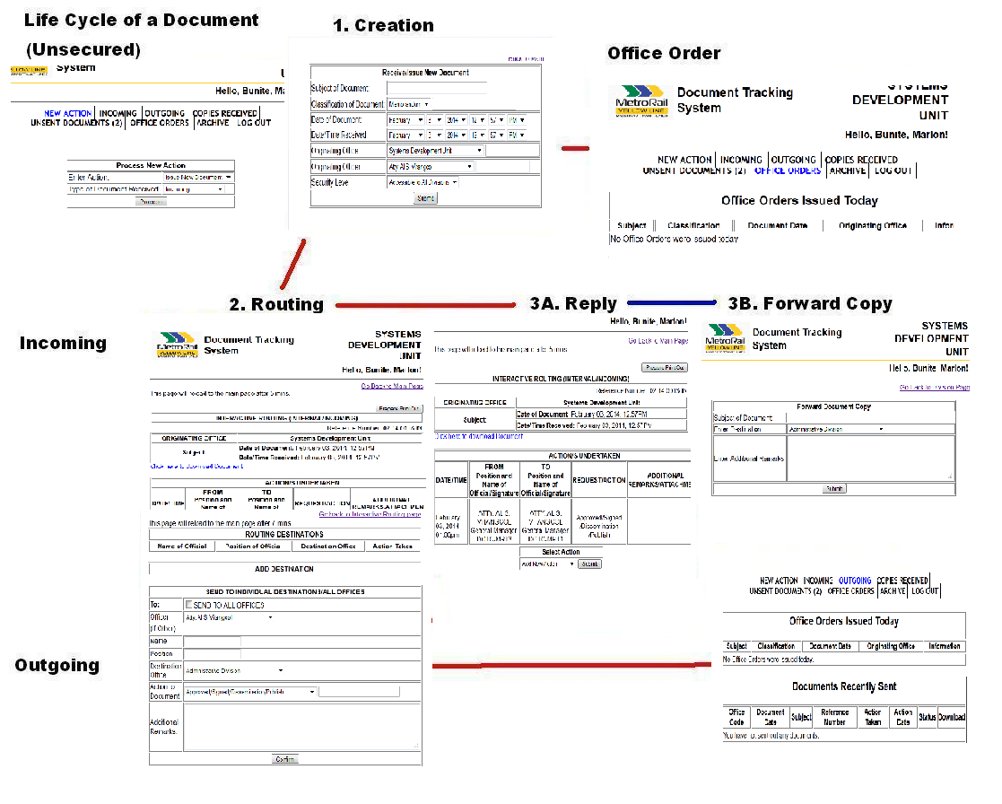

Slide 18
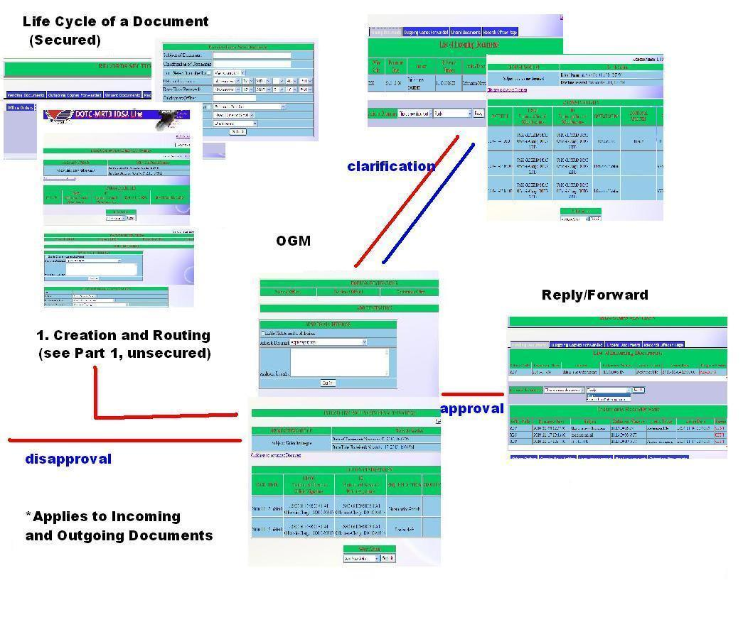

Slide 19
The Life Cycle of a Document (Step 3: Receive Document)
On the Main Page on the upper list of tabs is the Incoming and Outgoing tabs. The Incoming Tabs lists all the documents currently circulating internally, and the Outgoing lists all going outside
There are two sections on either of the tabs – the Documents Sent section shows all the documents the office sent out;
All the documents sent out to you will be shown on Pending Documents section; you have three options/actions to choose from with the document:

Slide 20
The Life Cycle of a Document (Step 3: Receive Document)
If you choose “Reply”, you are sent back to the Routing Report page
If you choose “Forward”, the next page asks you where to forward the document. Once the document is forwarded, the document closes and can no longer be replied to
Forwarding a document sends it out as an Outgoing copy (if an internal document)
The third choice, “Close” will simply acknowledge that the Document has been received. No replies are no longer necessary.

Slide 21
Additional Functions
The next page will show additional tabs in your Division Page

Slide 22
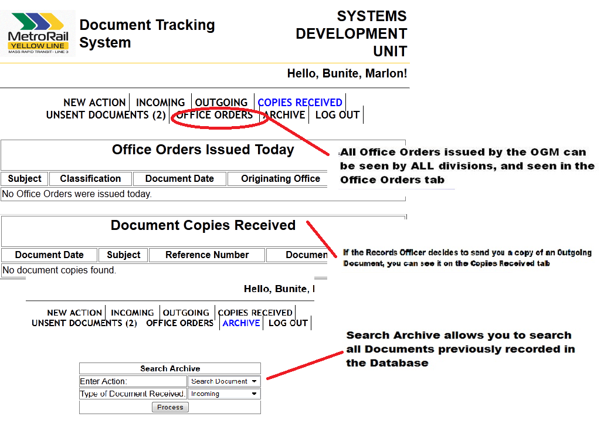

Slide 23
